Slide 1
Support Engineers Rostering
Team 35 Pitch

Slide 2
Outline
Team introduction
Members' team roles allocation.
Proposed approach
How to develop this project, front-end and back-end.
Technical Analysis
Specific problems and solutions, technique point of developing.
Team skills
Why choose us? Our skills and experience.
Summary
What we have covered today.
Notes:
This slide would be what we’re going to talk about in this pitch – should take about 1 minute

Slide 3
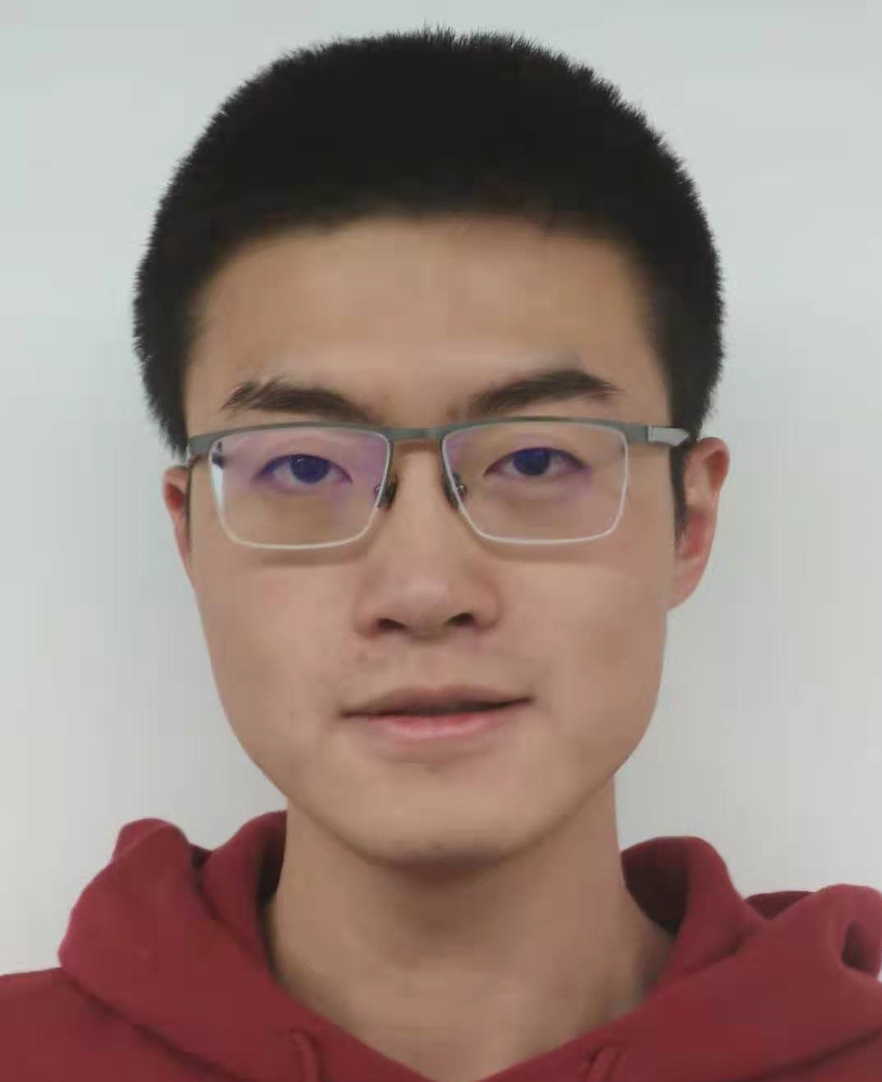
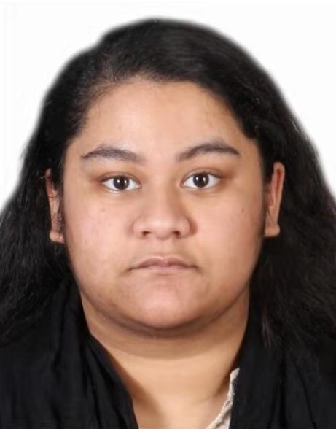
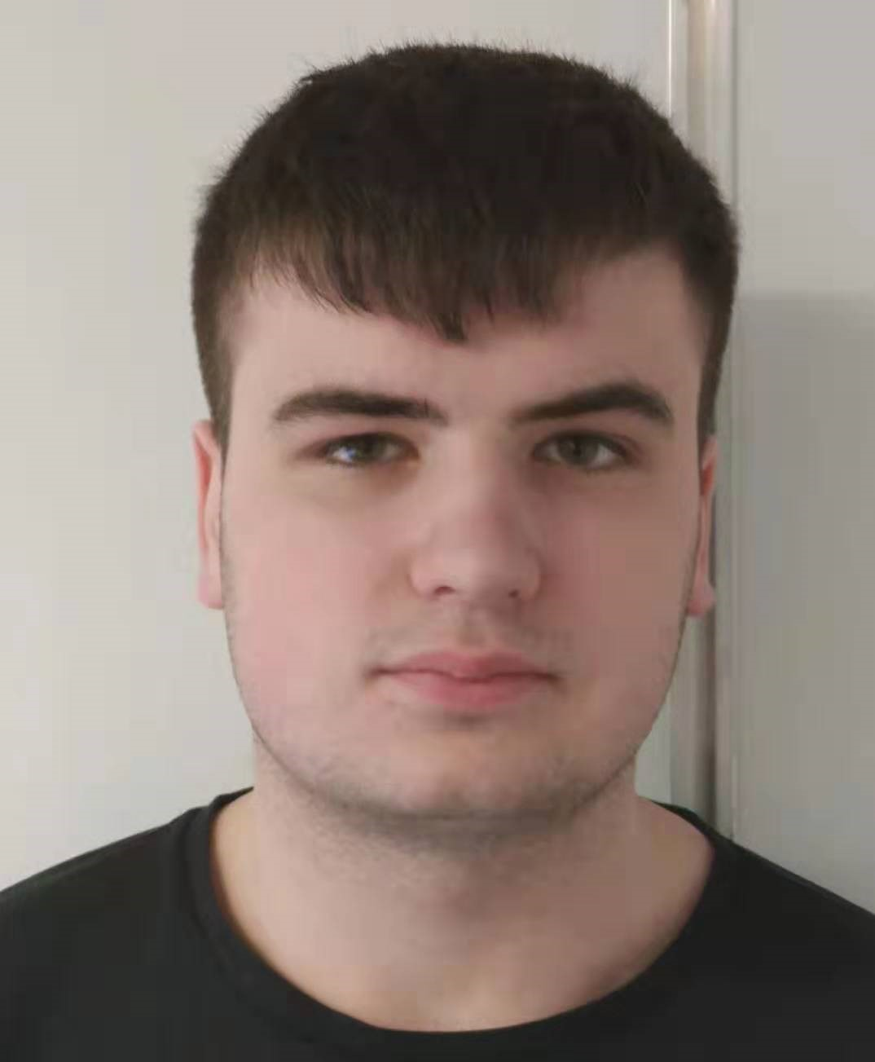
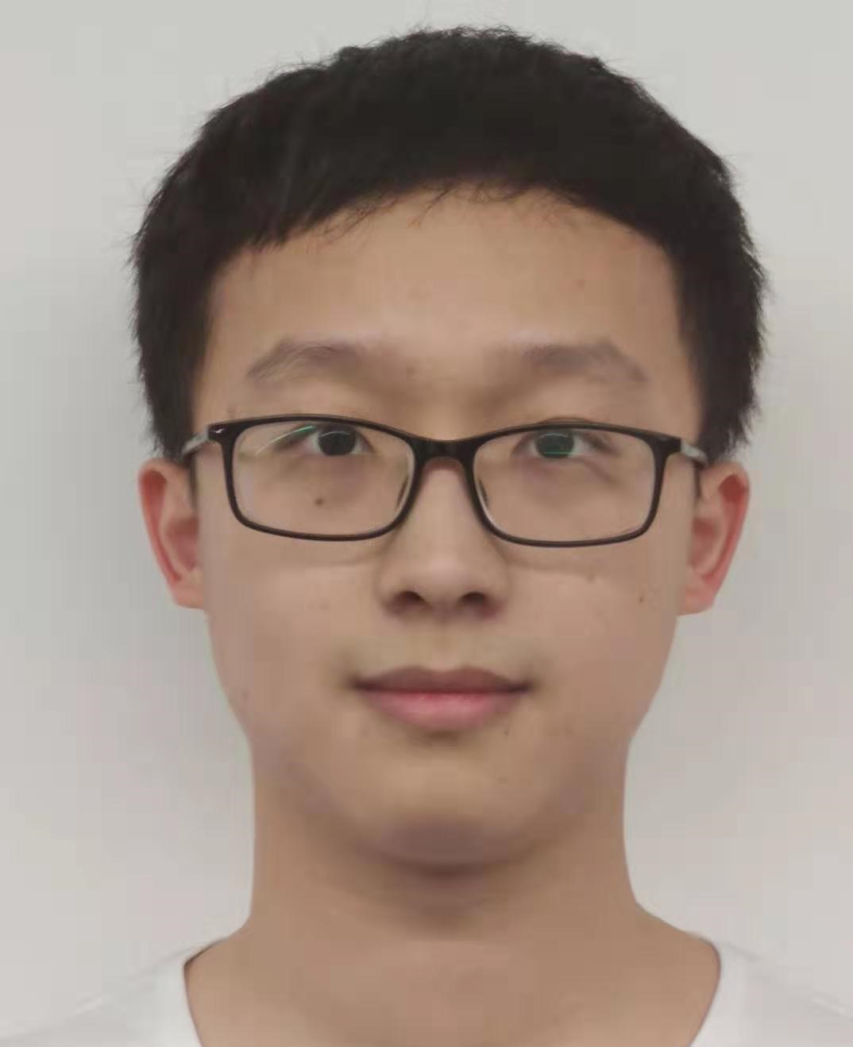
Team roles
Kejia Wu
Team Leader
Tajin Tasnuva
Gurjyot Kaur
Git Master
Liam Orrill
Nicole Millinship
Team Administrator
Xuanhao Li
Notes:
This slide explains everyone’s role in the project and what their skills are. It should also take 1 minute
We should use the same layout as Kobe and Leo's galaxian team slide and have a picture for each team member – this means that we don't need everyone to introduce themselves and waste time

Slide 4
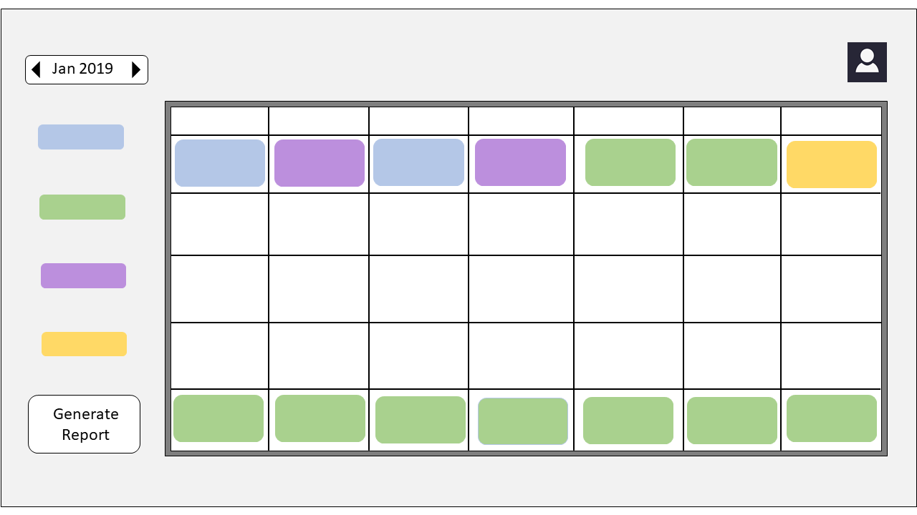
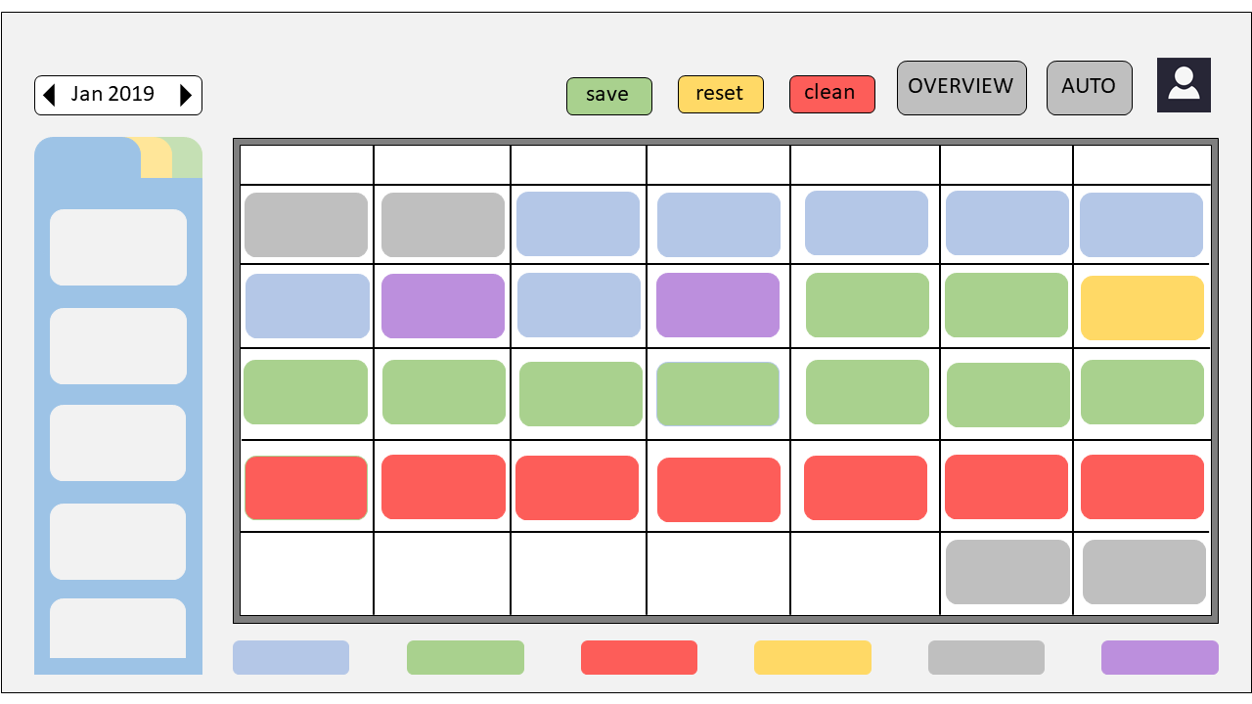
Proposed approach
Splitting the project into 3 different stages:
Creating the automated Rostering System and UI's
Creating the email system
Implementing an AI method to improve the Rostering system
We plan on carrying out rigorous testing throughout.
Creating two separate sites (together)
How we plan to layout the application

Slide 5


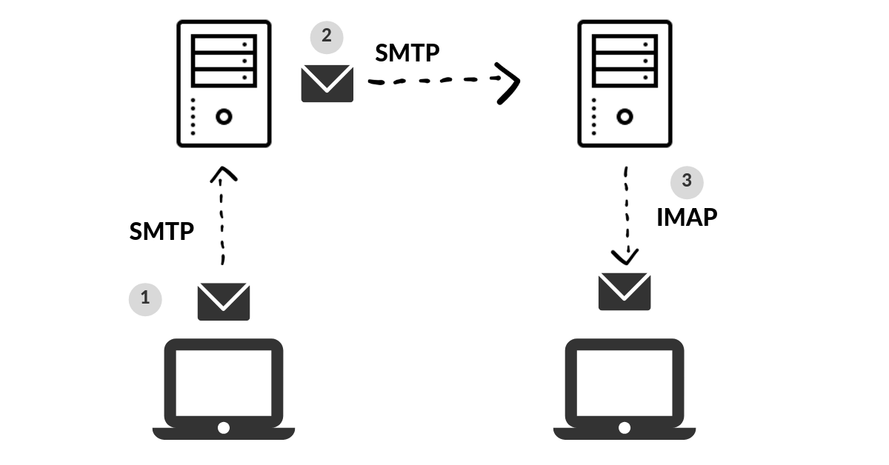
Technical analysis
Core web technologies:

Slide 6
Team Skills
Technical Skills
All have experience in developing web applications
Have all learned Java at university in the last year
Applied AI methods previously and know about various heuristics
Several of our members have studied art before
Learned about HCI concepts and how to apply them
Teamwork
Tajin works in IT service
Liam plays in a sports team
Keija and Gurjyot have experience working in a business company

Slide 7
Summary
Our team propose to create this project using PHP, JavaScript, HTML and CSS
Have a good idea of how we plan on laying the website out and how the user will interact with it.
Everyone has experience with creating web applications in the past
Everyone knows how to work in a team environment and knows the importance of communication to complete a task.

Slide 8
Thank you for listening
Any questions?

